Slide 1
Meteor
Christoffer Noring, Softhouse

Slide 2
About me
.net dev since 10 years
- Tech consultant in .net
I teach courses in
Angular 1 & 2
Meteor
Aurelia
Javascript dev + tooling
-Expert consultant in angularjs
- Member of angulars international group
of meetup organizers
Meetups ( in Gothenburg )
Angularjs Gothenburg , organizer
Software Craftsmanship Gothenburg, organizer
Frontend GBG, organizer

Slide 3
Meteor in 5
What
web framework written in NodeJs
Rapid prototyping, cross platform android, iphone etc, compare to Xamarin, Cordova ( cordova uder the hood )
Pub/subs pattern, Mongodb
History
first introduced in December 2011 under the name Skybreak
July 2012 Y- combinator, Andreessen Horowitz , $11.2M in funding
developed by the Meteor Development Group
“automatically propagate data changes to clients without requiring the developer to write any synchronization code”

Slide 4
Meteor
Web
DDP
Fullstack javascript
Node.js
MongoDb, replacable (eg mysql etc)
Handlebars ( Blaze ), replacable ( eg Jade etc )
Angular
Has its own package system
Supports mac, linux, windows
Compare it to firebase, but you have the database
Gives you concatenation + minification + hot deploy out of the box + source maps
Mini mongo
NodeJs
MongoDb

Slide 5
Get started
Install
Create your app
meteor create <name>
<name>.js
<name>.html
<name>.css
meteor // to run it
https://www.meteor.com/install
Scaffolds a project

Slide 6
App -breakdown
The data
<head>
<title>Simple</title>
</head>
<body>
<h1>Welcome to Meteor!</h1>
{{> hello}}
</body>
<template name="hello">
<button>Click Me</button>
<p>You've pressed the button {{counter}} times.</p>
</template>
if (Meteor.isClient) {
// counter starts at 0
Session.setDefault('counter', 0);
Template.hello.helpers({
counter: function () {
return Session.get('counter');
}
});
Template.hello.events({
'click button': function () {
// increment the counter when button is clicked
Session.set('counter', Session.get('counter') + 1);
}
});
}
if (Meteor.isServer) {
Meteor.startup(function () {
// code to run on server at startup
});
}
Where to place it in the view
Responding to events
Define
Showing the data from ”helpers”
<eventtype>.<selector>
What about database?

Slide 7
App with database
Define a collection to store data in
Define a form with input fields
Products = new Mongo.Collection('products');
if (Meteor.isClient) {
Template.products.helpers({
data: function () {
return "products";
},
products: function () {
return Products.find({}, { sort: { createdAt: -1 } });
}
});
Template.products.events({
'submit .products-form': function (event) {
console.log('save data');
event.preventDefault();
var text = event.target.name.value;
Products.insert({
title: text,
createdAt: new Date()
});
event.target.name.value = '';
// collect form values
// store in database
}
});
}
<template name="products">
<p>Let's create a product here</p>
<form class="products-form">
<input name="name" id="name" placeholder="product name" />
<p>
<button>Save</button>
</p>
</form>
<h2>Products</h2>
<ul>
{{ #each products }}
<li>{{ title }} {{ createdAt }}</li>
{{ /each}}
</ul>
</template>
Show created products
Loop created products
Create a product from form data

Slide 8
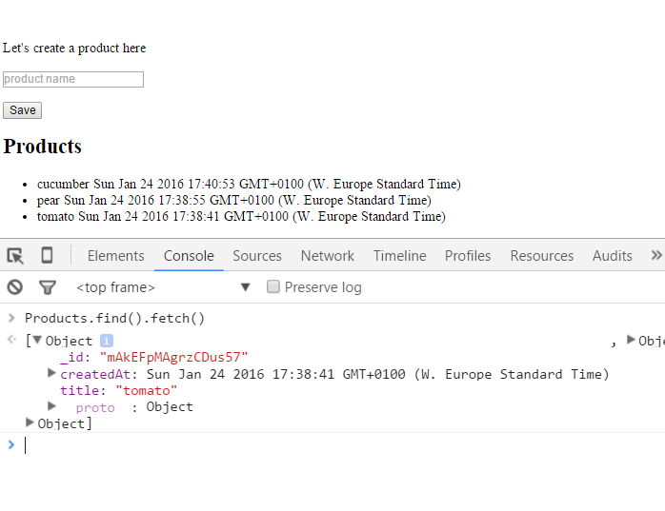
Debugging with Minimongo - collection
find() return cursor so fetch() is needed
to retrieve actual data
Interact with collection in the browser
through mini-mongo.
Remember to close this off in production
meteor reset // do this in command window to reset database

Slide 9
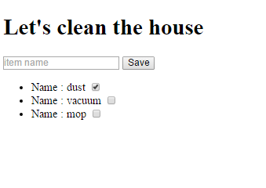
Second app - collaboration
Business case : lets clean the house
The first one to finish a task marks it as completed
Client 1
Client 2

Slide 10
Second app – naive code
Problem :
We grab the whole collection, could be millions of rows
What about security, everyone shouldnt see my data
Items = new Meteor.Collection('items');
if (Meteor.isClient) {
// counter starts at 0
Session.setDefault('counter', 0);
Template.cleanlist.helpers({
items: function () {
return Items.find({});
}
});
Template.cleanlist.events({
'click .item': function (event) {
Items.update(this._id, {
$set: { done: !this.done }
});
},
'submit .create-item': function (event) {
var name = event.target.name.value;
Items.insert({
name: name,
done: false
});
}
})
}
<head>
<title>clean</title>
</head>
<body>
<h1>Let's clean the house</h1>
{{> cleanlist}}
</body>
<template name="cleanlist">
<form class="create-item">
<input required name="name" placeholder="item name" />
<button>Save</button>
</form>
<ul name="items">
{{ #each items }}
<li class="item">
Name : {{name}}
<input type="checkbox" checked="{{done}}" />
</li>
{{ /each }}
</ul>
</template>
We are talking directly to a collection
in the frontend, OMG!!

Slide 11
Going enterprise
Organizing the code better so it scales better with features added
Limit who gets to see what, and recordset size
Add Login, different packages for social logins
Remove packages that makes the app unsecure
Add a ”Method layer”
Pub/sub with internal as well as external sources ”listeners”
React to changes – do some effect when something happens

Slide 12
Pub/sub, limit the dataset
We need to publish and subscribe
to get our data back
”meteor remove autopublish”
Todos = new Meteor.Collection('todos');
if (Meteor.isClient) {
Meteor.subscribe('all_todos');
Template.todos.helpers({
items: function () {
return Todos.find({});
}
});
Setup subscription
if (Meteor.isServer) {
Meteor.publish('all_todos', function(){
return Todos.find({});
});
1
The subset of data being returned
Here you can limit what data actually can be queried from
Limit by user, size, other properties
Meteor.publish('done_todos', function () {
return Todos.find({ done: true });
});
Meteor.publish('my_todos', function () {
return Todos.find({ user: this.userId });
});
2
3

Slide 13
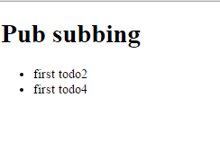
Pub/sub – merge publishes
Meteor.publish('done_todos', function () {
return Todos.find({ done: true });
});
Meteor.startup(function () {
if(Todos.find().fetch().length === 0){
Todos.insert({ name: 'first todo', done : false });
Todos.insert({ name: 'first todo2', done : true });
Todos.insert({ name: 'first todo3', done : false });
Todos.insert({ name: 'first todo4', done : false, user : 'pelle' });
}
Meteor.publish('my_todos', function () {
return Todos.find({ user: 'pelle' });
});
In client
My total recordset is a merge between 2 publish
definitions
Todos.find({})

Slide 14
Meteor – collection changes
Collection has changed, you want to update the UI in some way
User added to chat
Someone placed a bid etc
Observe changes on a collection query
if (Meteor.isClient) {
Meteor.subscribe('allYourVegetables', function () {
Products.find().observe({
added: function (res) {
console.log(res);
},
updated : function (item) {
console.log("something was updated");
console.log(item);
}
});
});
Document changed
Document added

Slide 15
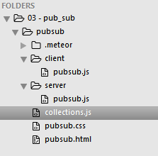
Organizing code
clients/ instead of isClient
server/ instead of isServer
if (Meteor.isClient) { }
if (Meteor.isServer){}
Define collections in a shared space
We can improve even more !

Slide 16
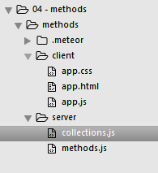
Add method layer
Collections can finally be on
Server-side where they belong
”meteor remove insecure”
Template.hello.events({
'submit .todo-form': function (ev) {
var name = ev.target.name.value;
Meteor.call('addTodo', name);
}
})
Calling method
Meteor.methods({
addTodo: function (name, who) {
// insert into database
console.log('calling serverside method');
}
});
Logging in command window
This is how you debug backend, are you drunk?!

Slide 17
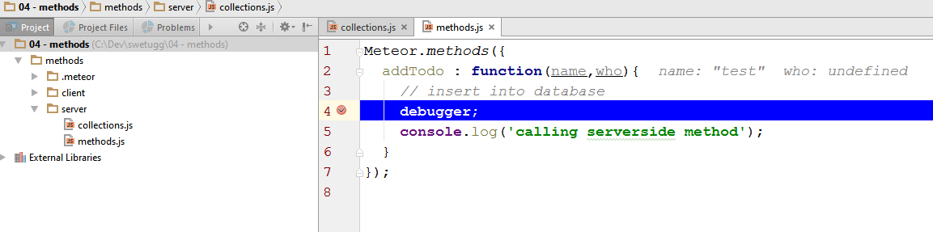
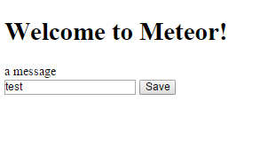
Better debugging serverside -webstorm
2
Set debugger on serverside, debug from IDE
1
User adds interacts with UI

Slide 18
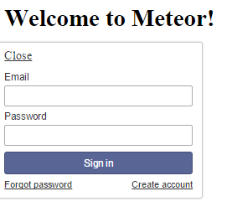
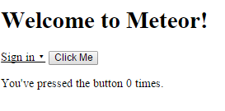
Add authentication
1
Gives you basic security
There are better ones but will get you started
meteor add accounts-password
meteor add accounts-ui
alanning:roles
2
Social logins:
accounts-google
accounts-twitter
accounts-facebook
login
create account

Slide 19
Authentication - code
Client
Server
Account-passwords, programmatic functions
this.userId
<template name="login">
{{#if currentUser}}
Logged in as : {{ user }}
{{ /if }}
</template>
Create user
Login
Logout
Update user
Template.login.helpers({
user: function () {
// use this one to save a post to a certain user
var id = Meteor.user().id;
return Meteor.user().emails[0].address;
}
});
And other helpers…

Slide 20
Authentication with roles
Meteor.publish('my_todos', function () {
if (Roles.userIsInRole(this.userId,
['administrator'], 'default-group')) {
return Todos.find({});
} else {
return Todos.find({ user: this.userId });
}
});
Meteor.startup(function () {
if (Meteor.users.find({}).fetch().length === 0) {
var users = [
{ name: "Normal User", email: "normal@example.com", roles: ['normal'] },
{ name: "Admin User", email: "admin@example.com", roles: ['administrator'] }
];
_.each(users, function (user) {
var id;
id = Accounts.createUser({
email: user.email,
password: "password",
profile: { name: user.name }
});
if (user.roles.length > 0) {
// Need _id of existing user record so this call must come
// after `Accounts.createUser` or `Accounts.onCreate`
Roles.addUsersToRoles(id, user.roles, 'default-group');
}
});
}
});
User only sees own data
Admin gets to see everything
Create admin + normal users + create groups

Slide 21
Make collections more secure
Posts.allow({
insert: function (userId, post) {
// can only create posts where you are the author
return post.createdBy === userId;
},
remove: function (userId, post) {
// can only delete your own posts
return post.createdBy === userId;
}
// since there is no update field, all updates
// are automatically denied
});
Allow a CRUD based on for example who you are
Deny insert depending on for example what the data is
// In a file loaded on the server (ignored on the client)
Posts.deny({
insert: function (userId, post) {
// Don't allow posts with a certain title
return post.title === "First!";
}
});

Slide 22
Routing
meteor add iron:router
<template name="main">
<h1>This is the master page</h1>
{{ > menu }}
<div style="border: solid 1px lightgray; padding: 10px; min-height: 300px">
{{ > yield }}
</div>
{{ > bottom }}
</template>
<template name="register">
register
</template>
Content rendered here
Router.route('/register', {
name: 'register'
});
Router.route('/login', {
name: 'login'
});
Router.route('/', {
name: 'home'
});
Router.configure({
layoutTemplate: 'main'
});
<ul class="menu">
<li>
<a href="{{pathFor route='register'}}">register</a>
<a href="{{pathFor route='login'}}">login</a>
<a href="{{pathFor route='home'}}">home</a>
</li>
</ul>
Create links
Master page

Slide 23
External apis and polling
Call external api
Poll it with a certain interval
Add result to collection that can be published
meteor add percolate:synced-cron
meteor add http
Scheduling
http
Based on later.js

Slide 24
External api - code
Yes this is parsed to an actual number
Define polling job
Meteor.methods({
fetchSomeData: function () {
// Get top songs from iTunes server
HTTP.get('url_to_data', function (error, response) {
var datacollection = [];
var entries = topsongsResponse.data;
var sort = 0;
_.each(entries, function (entry) {
var item = {};
item.prop = entry.prop;
// and so on
datacollection.push(item);
}, this);
// Delete all existing entries from database
Entries.find().forEach(function (entry) {
Entries.remove(entry._id);
});
// Insert new songs into database
_.each(datacollection, function (item) {
Entries.upsert(item._id, item);
}, this);
});
}
});
Define get method for external data
SyncedCron.options.collectionName = 'job';
SyncedCron.add({
name: 'what to fetch',
schedule: function (parser) {
return parser.text('every 10 minutes');
},
job: function () {
Meteor.call('fetchSomeData');
}
});
// Startup
Meteor.startup(function () {
// Start jobs
SyncedCron.start();
});
Fetch and parse
Clean old data
Publish data
Meteor.publish(externaldata', function () {
return Entries.find();
});
Update with newly fetched data

Slide 25
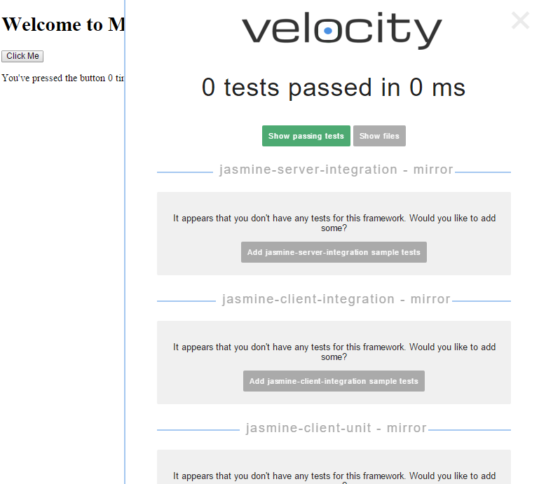
Testing
Start you your app with meteor
meteor add sanjo:jasmine
meteor add velocity:html-reporter
App running
Test overview + you can add tests

Slide 26
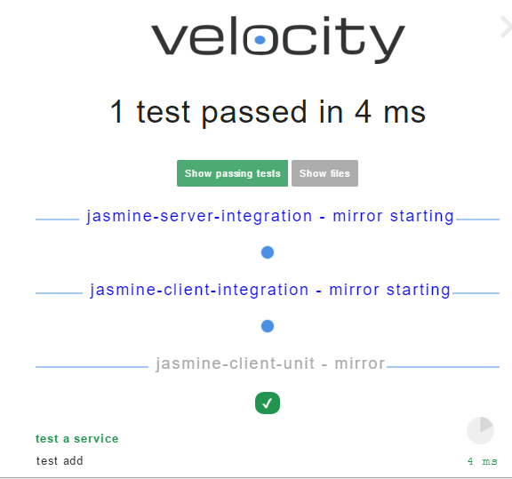
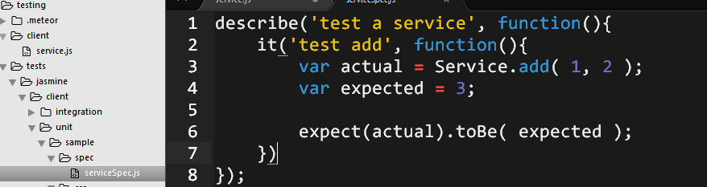
Testing – unit testing
Definition
Test
Test itself
Test result

Slide 27
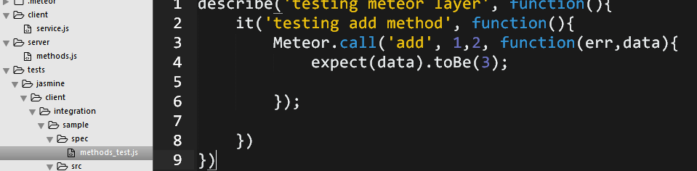
Testing – integration testing
Test call to method layer
It is async, so expect to get a response on a callback

Slide 28
Meteor promises and es7 syntax
meteor add deanius:promise
Promises and generators – how cool is that
2
return Meteor.callPromise("getUser", arg1,arg2)
.then(function (result) {
return Meteor.callPromise("getProductsByUser", , result);
})
.then(function (result) {
return result + " :)";
});
1
getUser()
.then(getProductsByUser)
.then(getSomethingElse)
.catch(errorCallback)
Or if generators are your cup of tea
What we are used to by now
3
Meteor.runAsync(function* () {
var out1 = yield Meteor.callPromise(“getUser", "1", "2")
var out2 = yield aBitLater(() => 3, 500)
var result = yield Meteor.callPromise(“getProductsByUser", out1, out2);
console.log("Async is done.", result);
return result; })
.then(result => template.$("#promiseOutput").html(result))

Slide 29
Deploy
swetugg16.meteor.com
Hosting
3
1a
Modulus.io
For that afterwork app do:
meteor deploy <appname>.meteor.com
Meteor galaxy
Digital ocean
For more serious deployment and hosting there are more than one option:
2
Deployment
1
Meteor Up
meteor-deployment-manager
Prepare for deploy
npm install -g mup
App needs to be on github
meteor deploy
deploy.json
npm
OR
npm
mup.json
demeteorizer
db
Turn into nodejs app
Where to put app etc..

Slide 30
Why Not Meteor
Why Meteor
Fast development
Rich eco system of packages
Javascript everywhere
Solves the reactive, sync part part well in an eco system of apis, services etc..
Things are changing a lot still
Debugging experience only really good in webstorm. Lacks good support in visual studio, abandoned tool project
Good support only for MongoDb

Slide 31


Learn more
Jebin B V
David Turnbull

Slide 32


Thank you for listening
Christoffer Noring
chris_noring
github.com/softchris
swedecoder.wordpress.com
christoffer.noring@softhouse.se

